Slide 1
LEPR Gene:
Function, Structure, and Implications
---KunQi Zhang
Tools:
NCBI, UniProt, KEGG, GeneCards
Objective:
To explore the function and biological importance of the human LEPR gene using online genomic and proteomic databases.

Slide 2
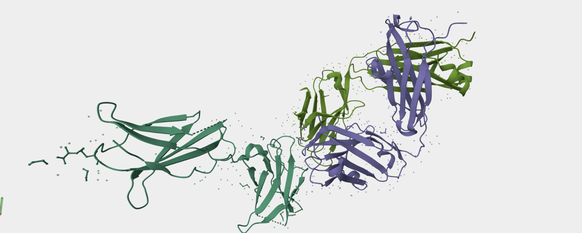

Slide 3
Next steps are:
1,Search for both human and mouse gene sequences from NCBI or Ensembl;
2,Compare their similarity and conservation;
3,Explore the biological pathways involving LEPR and its link to diseases;
4,If there are drug-related compounds in its reaction pathway, I’ll look deeper into them.

